Slide 1


Evaluation of a Shamanic
Interface for Interaction with Cultural
Gestures in Virtual Environments
Pedro Pais de Sousa da Costa Carvalho - up201306506
Supervisor: António Coelho
Co-Supervisor: Leonel Morgado

Slide 2

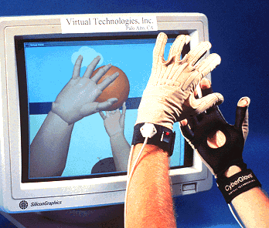
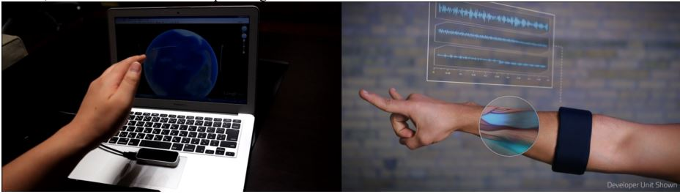
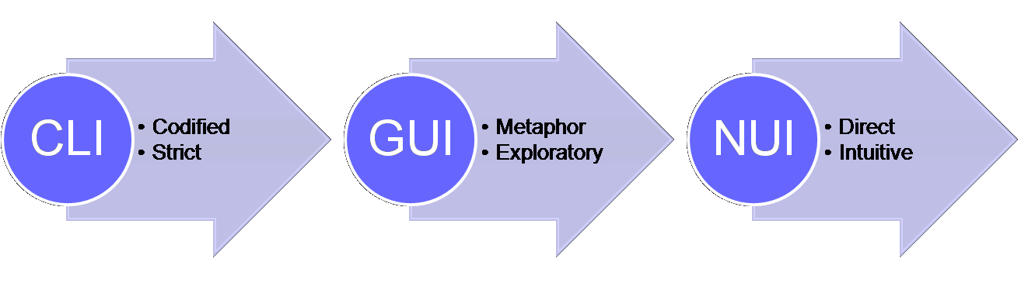
‘Natural User Interfaces’
Context
“A natural user interface is a user interface that is effectively invisible, and remains invisible as the user continuously learns increasingly complex interactions.”

Slide 3
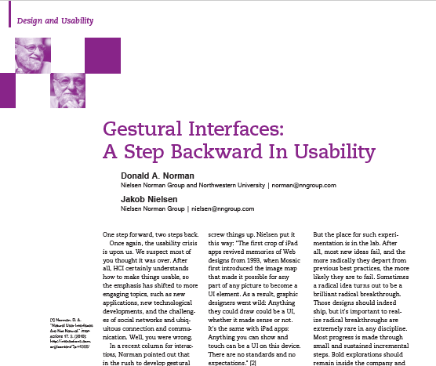
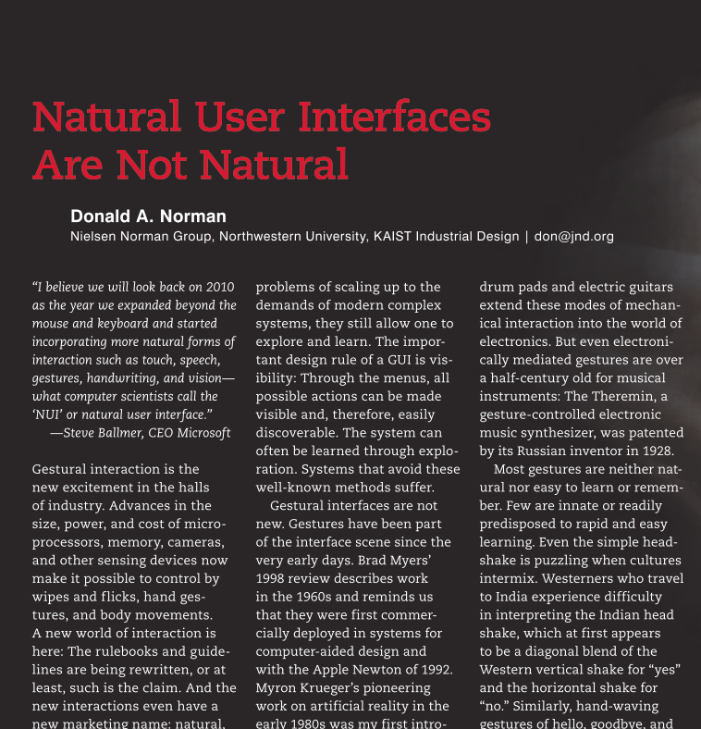

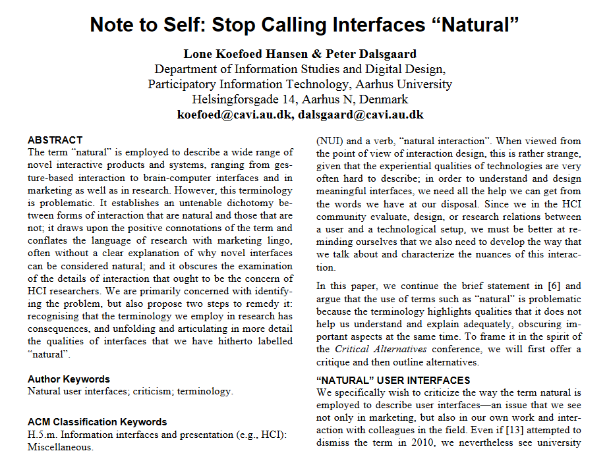
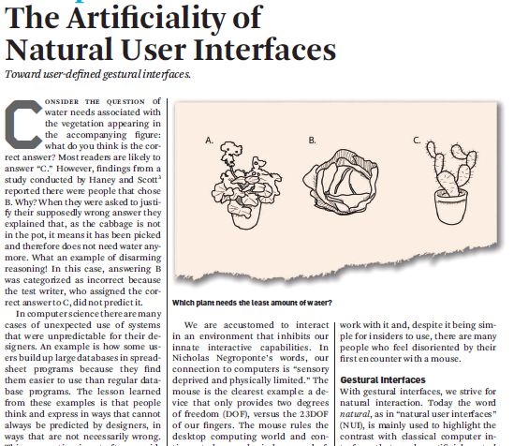
Motivation
Notes:
“Most gestures are neither natural nor easy to learn or remember. Few are innate or readily predisposed to rapid and easy learning. Even the simple headshake is puzzling when cultures intermix. Westerners who travel to India experience difficulty in interpreting the Indian head shake, which at first appears to be a diagonal blend of the Western vertical shake for ‘yes’ and the horizontal shake for ‘no.’”

Slide 4

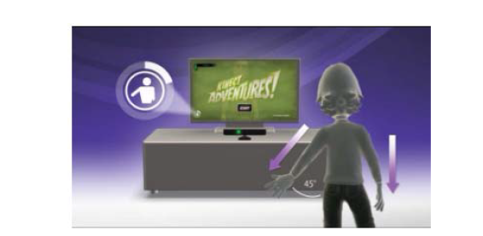
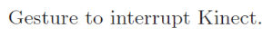
Shamanic Interface
Proposal
Name taken from a book that describes
its idealized concept:
“It’s called the shamanic interface because it was designed to be comprehensible to all people on earth, regardless of technological level or cultural background.”
“The basic idea (...) is that the creation of a concern-separation layer between the gestures being executed by the users and their interpretation by computing systems can contribute both to the access by users with special needs and to all users in general, by enabling customized approaches to gesture-based control.”

Slide 5
Create Tool and Provide Empirical Data and Analysis
Objectives/Goals
Focusing on user culture contributes to the Learning Rate and Capacity of commands
Focusing on user culture contributes to the Retention and Memorization of commands and concepts
Focusing on user culture contributes to the Satisfaction and Immersion of the experience

Slide 6
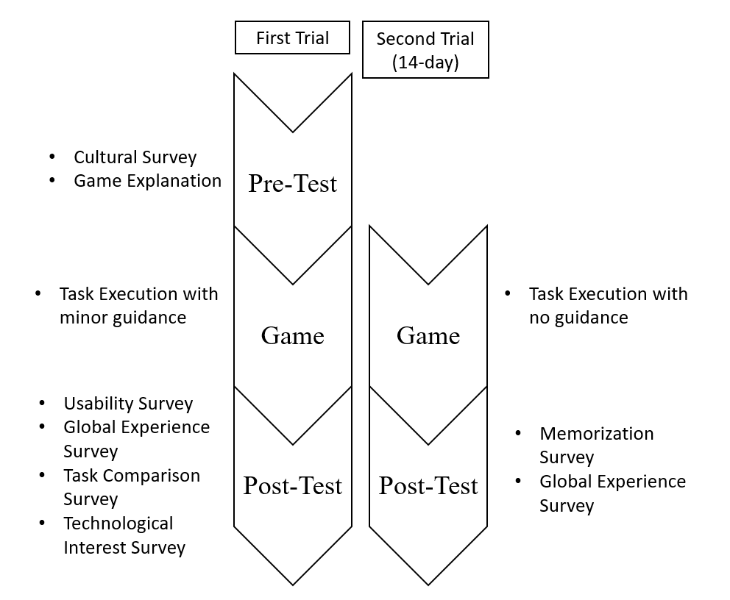
User Trials
Solution Planning
Performed in a control environment devoid of other people or active equipment.
Seeks to find useful evaluation data of two primary types, observational data and user opinion data.
Two trials required due to necessity of evaluating recall and recognition.

Slide 7
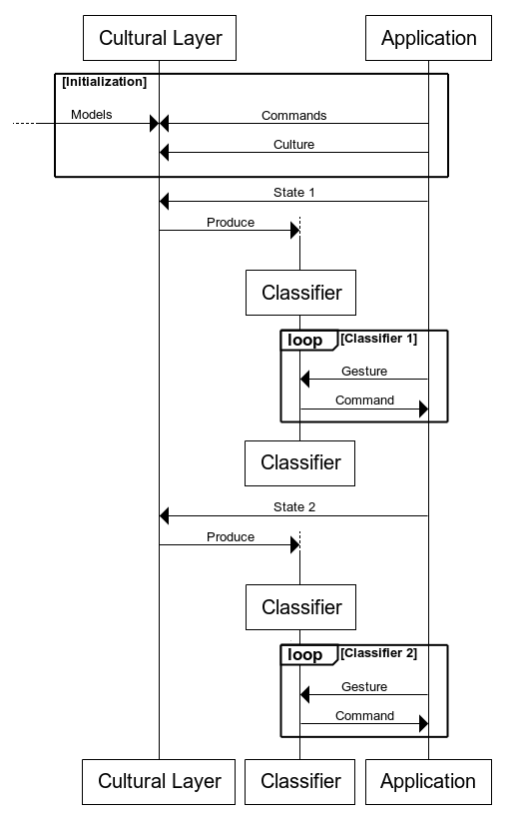
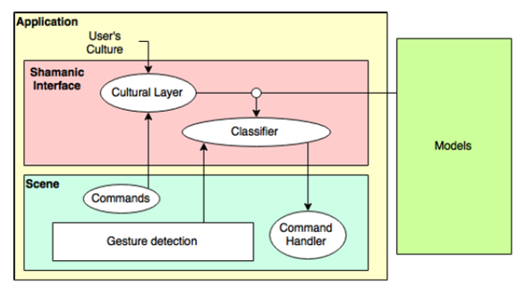
Research Tool based in a Shamanic Interface
Solution Planning
Game running on the Unity Engine, first person perspective, controlled entirely through hand gestures, using a Leap Motion Device
Gestures recorded and stored as Hidden Markov Models, using the Accord.NET Framework.

Slide 8
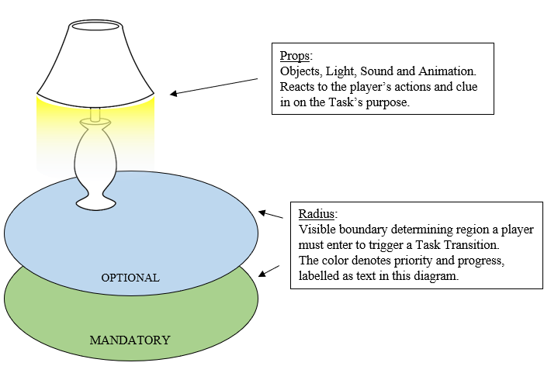
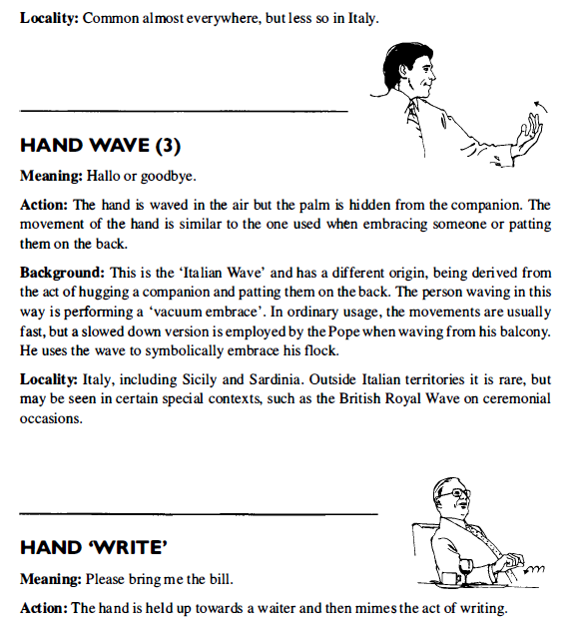
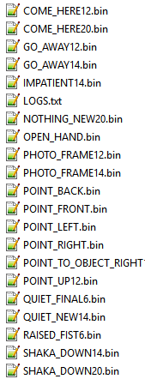
Culturally Significant Human Gestures: Emblems
Solution Planning/Implementation
In the game, Tasks are completed by performing Emblematic gestures. Users identify the task’s priority and its context from its visible elements.

Slide 9
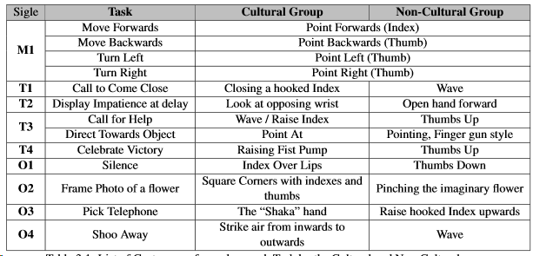
Culturally Significant Human Gestures: Emblems
Solution Planning/Implementation
Cultural and Non-Cultural Groups differ in gesture set. The Cultural Group receives the expected, well-fit Emblems corresponding to the Task’s expectations. The Non-Cultural Group receives meaningful, yet not first choice, gestures appropriate for the Task objective, yet not apt to communicate the Task’s context.

Slide 10
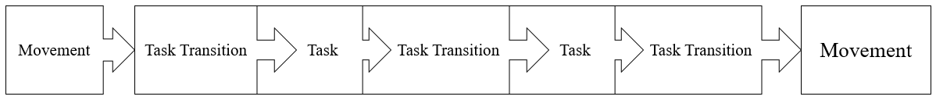
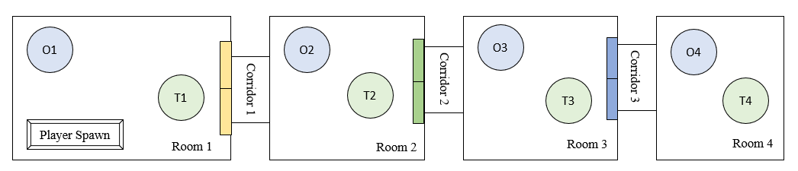
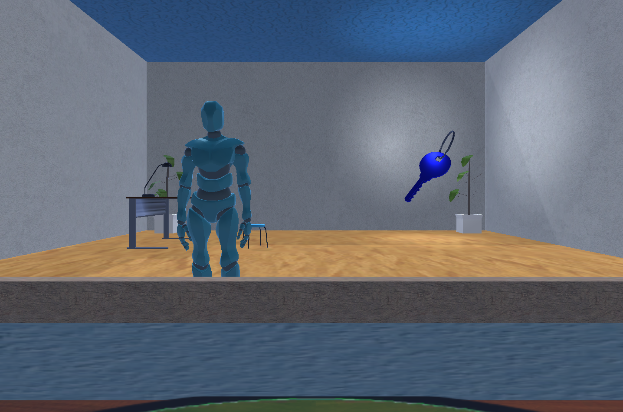
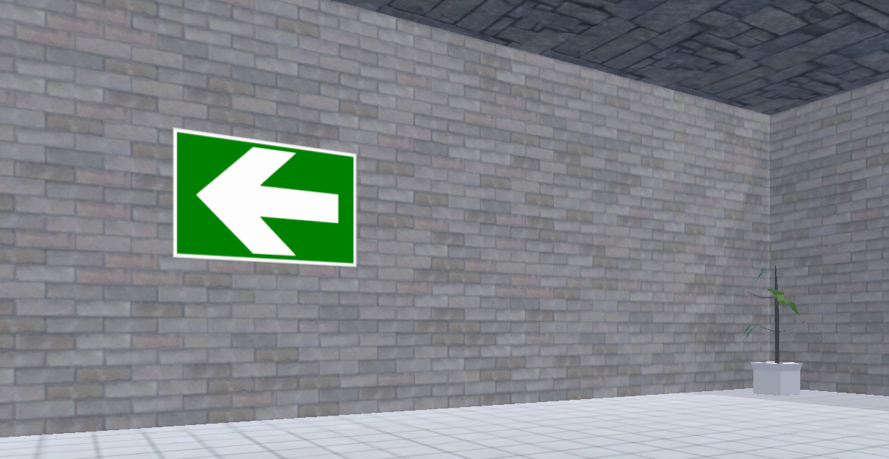
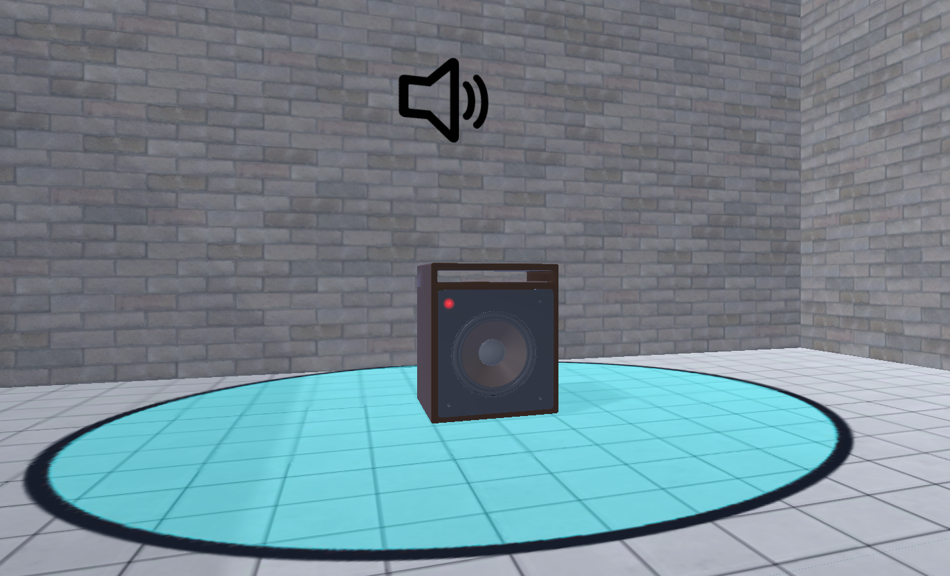
Game
Solution Planning/Implementation

Slide 11
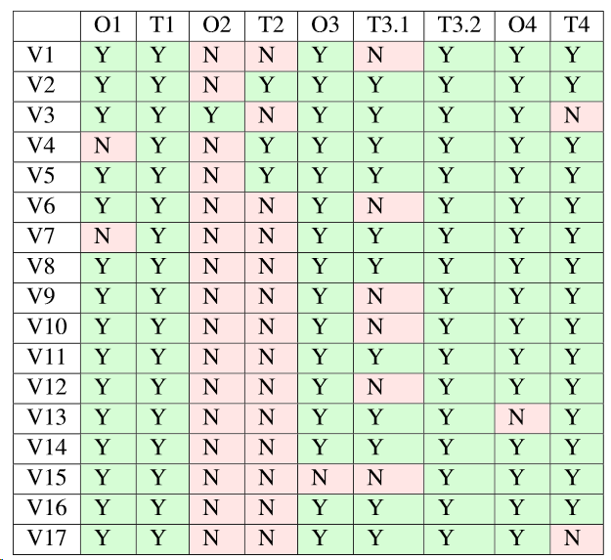
Sample, Pre-test Cultural Validation
Results
17 volunteers, aged 18 to 24, randomly distributed between the groups.
All of portuguese culture.
All student of University of Porto, but of varied faculties.
None had first-hand experience with the technology.
One drop-out after first trial.
One potential outlier in Non-Cultural Group.

Slide 12
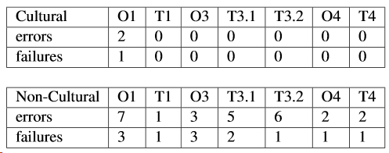
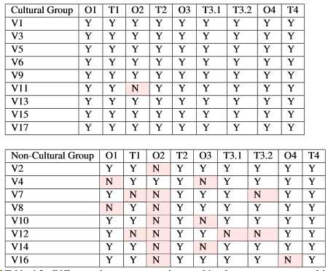
Learning Rate and Capacity
Results
On the first game, the Cultural Group had a significantly higher performance observation versus the Non-Cultural.
The majority of the Non-Cultural Group have rejected or found issues with more than one of the tasks prior to completion.
Most of the Non-Cultural Group volunteers required a reminder of the Gesture Set during the Task Comparison Survey. Two requested to keep the explanation sheets and were denied.

Slide 13
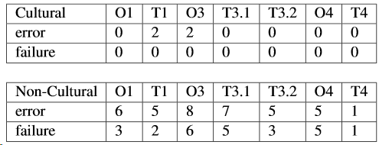
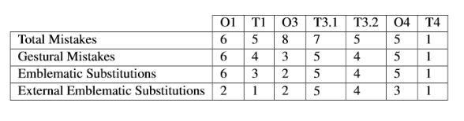
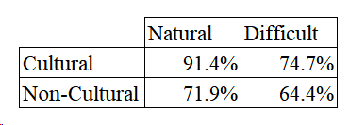
Retention and Memorization
Results
After a long time without experiencing the game, the Cultural Group managed to maintain their performances.
The Non-Cultural Group ended up showcasing a worse performance with further errors and failures.
The majority of user error committed by the Non-Cultural Group was related to performing the wrong gestural command. The majority of these, in turn, involved using Gestures
Both groups requested a similar amount of help, and reported similar levels of confidence. However, the Non-Cultural Group’s certainties can be applied to as misplaced (Wrongful Recognition).

Slide 14
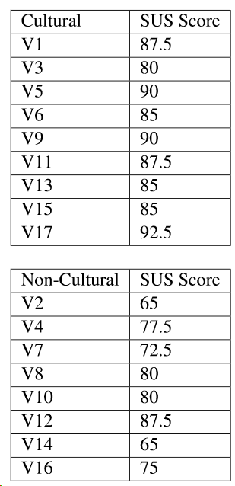
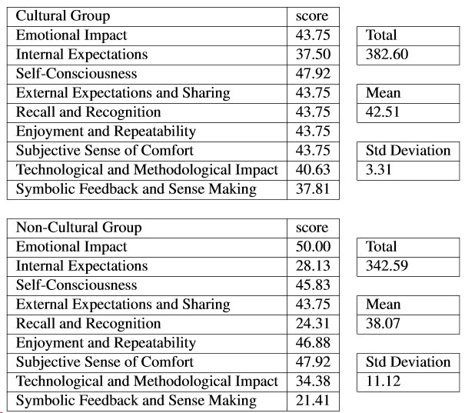
Satisfaction and Immersion
Results
Usability parameterized by System Usability Scale demonstrably indicates that the Cultural Group felt more assuredness and satisfied with their experience.
Global Experience survey of achievement, comfort, sharing and immersiveness indicators have not yielded significant evidence to support a difference between the groups.

Slide 15
Future Work - Investigate using a Shamanic Interface Application:
Future Work
Focusing on contributes to attainability of higher Richness and Depth of interaction.
Focusing on user cultural leads to higher discoverability of uninstructed gestural commands.
Verify Technological Interest (or potential other factors) as a mitigator of cultural impact.
Usage of more immersive technology and higher focus on affective virtual environments towards improved memorability.

Slide 16

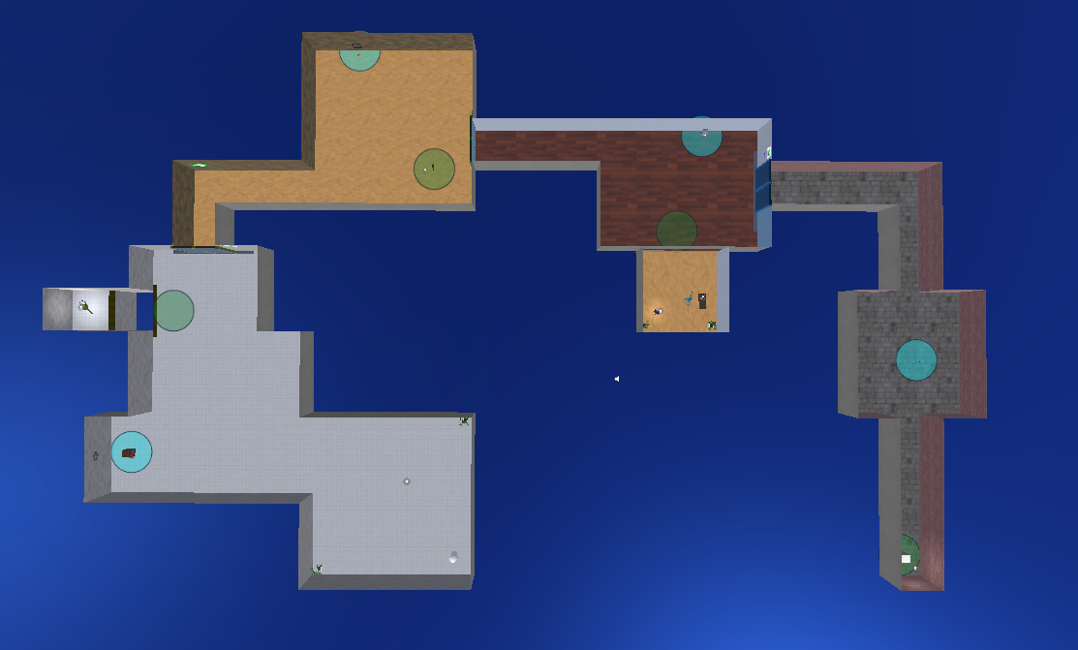
Thank You!
https://youtu.be/zrCoV-caw4w

